Slide 1
McGill Students’ Actuarial Association
Notes:
Thank for coming
Most information from this presentation taken from beanctuary.com, so if you’ve already seen the website, there may be some repeated information
However I will try to make the information entertaining
Leave questions until Q&A, Powerpoint will be uploaded to facebook page.

Slide 2
Executive Team
Kyla and Rebecca | Co-Presidents
Tara | VP Communications
Sara P. | VP External
Rachel | VP Internal
Asia | VP Academic
Shane | VP Finance
Sara W. | VP IT
Mohammed | First Year Representative
Sophia, George | Members at Large

Slide 3
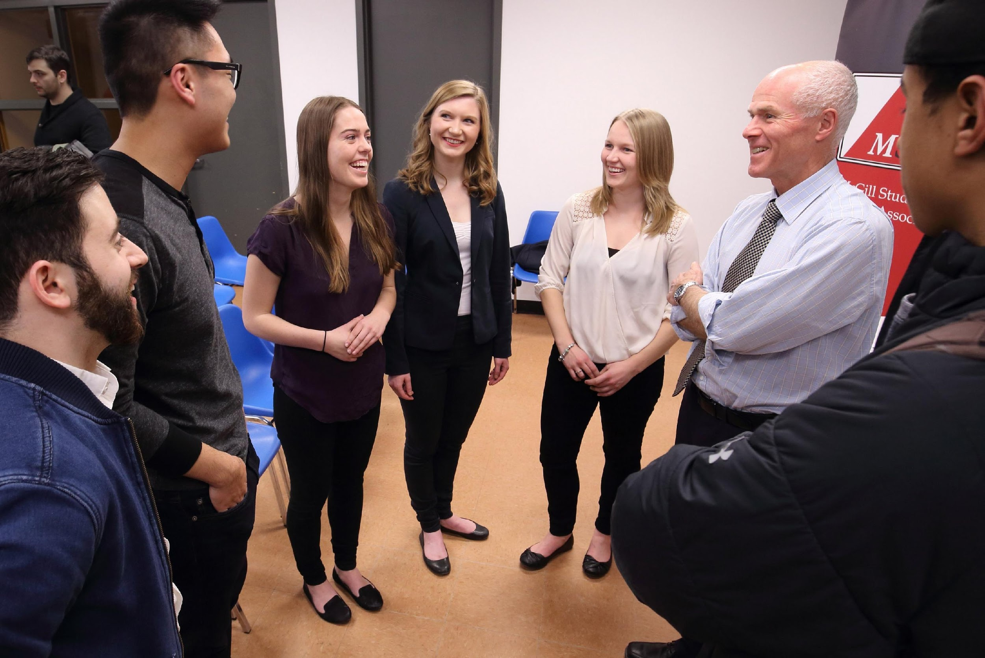
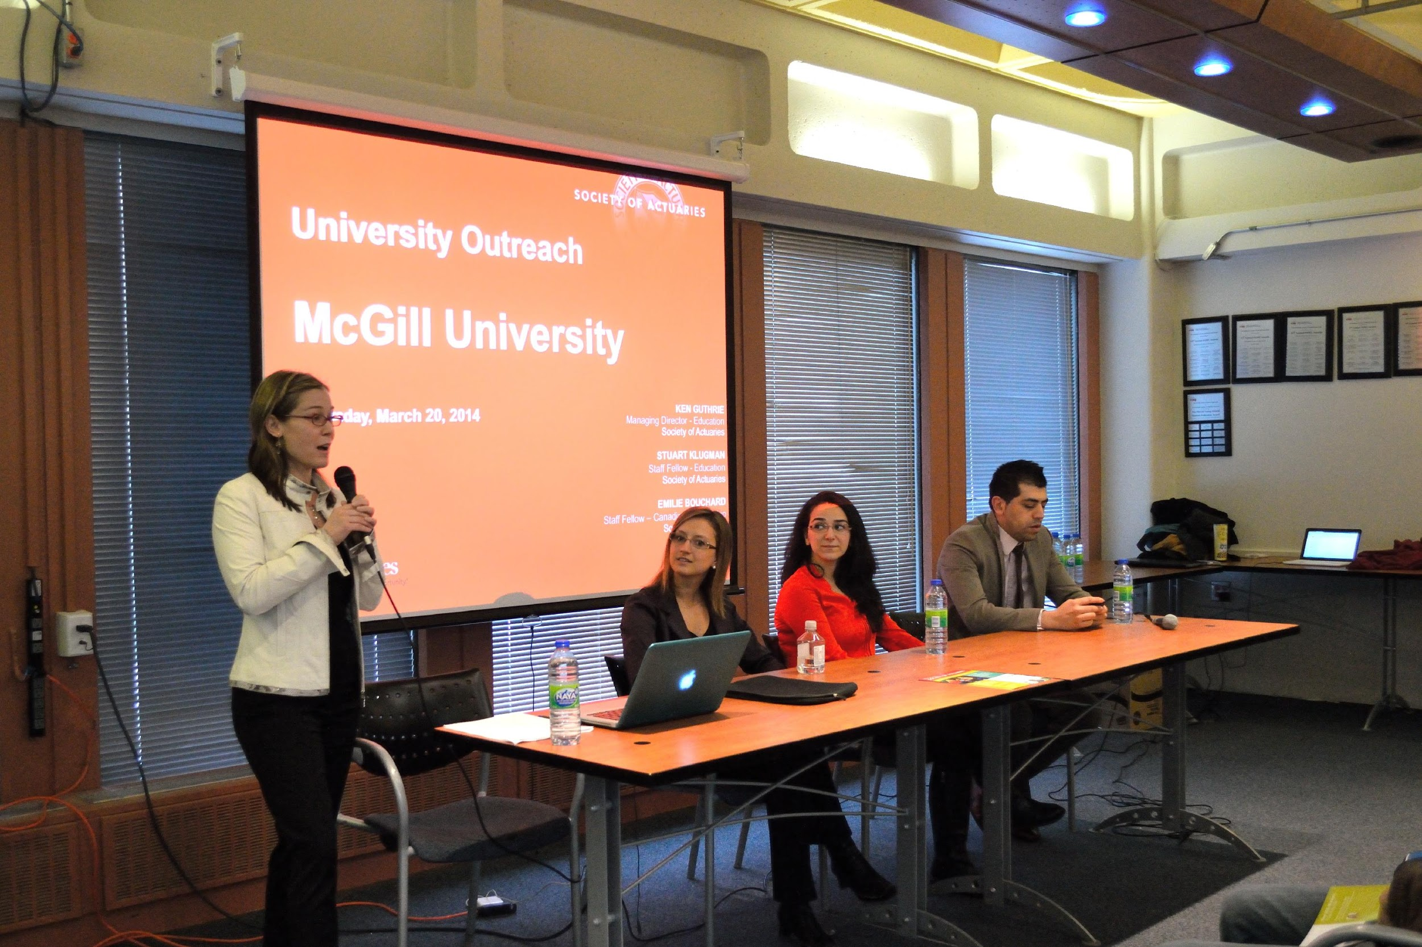
Who Are We?
Founded in 2013
Help students learn about the actuarial field
Connect students with actuarial interests
Provide resources, support and networking opportunities
Communicate about job opportunities

Slide 4
What Does an Actuary Do?
Experts in data analysis
Pricing premiums
Sustain the targeted profitability
Notes:
SOPHIA
Prediction using statistical models, not crystal balls
Usually work for insurance companies
This is important because these events are usually associated with cash outflows for the company.
Examples include: hurricanes, death, car accidents
Different concentrations such as “Life”, “Property Casualty”
B
Based on the above work, you can determine how much money an insurance company will have to pay out for each person
So depending on how much profit you want to make, you can set a premium (above this amount) which will make you money
With all these people purchasing insurance, the law of large numbers apply, so if your model is correct then estimation is good
C
Actuaries do make lots of money, that’s why it’s such a popular profession. How much?
Video: http://riskisopportunity.net/tv-uni-09-education.aspx

Slide 5
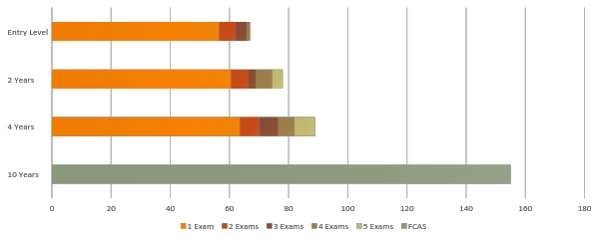
Salary Levels for Actuaries
Average Entry Level = CAD $60,000 +
Notes:
SOPHIA
These figures are average annual salaries for Casualty actuaries working in the states.
Figures for Canada are a little more bleak. For one, it will be very unlikely that you’ll be hired with one exam
Note that as years of experience increases, variance in salary levels also increase,
for example after 15 years and an FCAS, the 10th and 90th percentile salary levels are 148-361

Slide 6
Different Tracks for Actuaries
SOA (Society of Actuaries)
Life Insurance (Retirement, Pension, Health Benefit), Investment
CAS (Casualty Actuarial Society)
Property and Casualty Insurance (Auto, Property, Commercial Insurance)
Notes:
VICKY

Slide 7
SOA (Society of Actuaries)
CAS (Casualty Actuarial Society)
Notes:
VICKY

Slide 8
Pros
Cons
Exam Support
Stress
Hours
Hard Work
Salary
Competition
Notes:
VICKY
Pros
Actuaries work typical 9-5 jobs, unlike finance people who do crazy 100 hour weeks. Especially Investment Banking
Salary starts out decent and has huge growth potential
Exam support offered by companies mean:
Paid study time
Paid study materials
Paid exam fees
Cons
Especially in Canada, there are a lot of people who want to be actuaries
Waterloo keeps spitting them out
Getting a placement is a lot harder here than in the states. Typically 3-4 exams is a safe bet for getting a job, whereas in the states 2 is usually enough
Exams are not easy, and you have to put thousands of hours into them over your lifetime
Some people just get burnt out and switch professions
As a job involving risk calculation, there is a certain stress level associated with it. If you screw up, really bad things happen.

Slide 9
Typical Track to an ACAS
Exams
+
Other
=
ACAS
P
VEE’s
FM
MFE
OC1/OC2
C
S
5
6
For More Information:
http://www.casact.org/admissions/process/
Notes:
SOPHIA
Each exam stands for…
Equivalent courses at mcgill:
Math 323 for P
Math 329 for 90% of FM
Math 430 for the last 10% of FM and for Part of MFE
Start with P if you’re comfortable with calculus and probability. Start with FM if you’re more financially oriented.
Exam order doesn’t matter. P and FM are about the same difficulty, and then MFE, MLC and C are slightly harder than the first 2
Validation by Educational Experience
Economics: econ 208, 209 (or micro macro)
Corporate Finance 341, 342
Applied Statistics (econometrics)
FAP
FAP is a self–paced, e–Learning course composed of eight modules where candidates acquire and use knowledge that is distributed and facilitated by electronic means. : This course teaches candidates about the business environment and exposes them to real–world situations
APC
Associateship Professionalism Course
The course covers professionalism, ethics and legal liability and makes extensive use of the case study method.

Slide 10
Typical Track to an ASA- New Curriculum
Exams
+
Other
=
ASA
P
VEE’s
FM
FAP
IFM
APC
LTAM
STAM
SRM
For More Information:
http://www.soa.org/Education/Exam-Req/edu-asa-req.aspx
Notes:
SOPHIA
Each exam stands for…
Probability
Financial Mathematics
Investments and financial Markets
Long Term Actuarial Models
Short Term Actuarial Models
Statistics for Risk Modelling
Equivalent courses at mcgill:
Math 323 for P
Math 329 for 90% of FM
Math 430 for the last 10% of FM and for Part of MFE
Start with P if you’re comfortable with calculus and probability. Start with FM if you’re more financially oriented.
Exam order doesn’t matter. P and FM are about the same difficulty, and then MFE, MLC and C are slightly harder than the first 2
Validation by Educational Experience
Economics: econ 208, 209 (or micro macro)
Corporate Finance 341, 342
Applied Statistics (econometrics)
FAP
FAP is a self–paced, e–Learning course composed of eight modules where candidates acquire and use knowledge that is distributed and facilitated by electronic means. : This course teaches candidates about the business environment and exposes them to real–world situations
APC
Associateship Professionalism Course
The course covers professionalism, ethics and legal liability and makes extensive use of the case study method.

Slide 11
VEE’s at McGill- Subject to Change for New Upcoming Curriculum
ECON 208
Economics
ECON 209
MGCR 341
VEE’s
Finance
FINE 342
ECON 337
Applied Statistics
ECON 338
Notes:
SOPHIA
Each exam stands for…
Equivalent courses at mcgill:
Math 323 for P
Math 329 for 90% of FM
Math 430 for the last 10% of FM and for Part of MFE
Validation by Educational Experience
Economics: econ 208, 209 (or micro macro)
Corporate Finance 341, 342
Applied Statistics (econometrics)
FAP
Fundamentals of Actuarial Practice e Learning Course: This course teaches candidates about the business environment and exposes them to real–world situations
APC
Associateship Professionalism Course
Half a day
professionalism, ethics and legal liability and makes extensive use of the case study method

Slide 12
Exams at McGill
P
MATH 323
Exams
FM
MATH 329
MFE
MATH 430
Notes:
SOPHIA
Each exam stands for…
Equivalent courses at mcgill:
Math 323 for P
Math 329 for 90% of FM
Math 430 for the last 10% of FM and for Part of MFE
Validation by Educational Experience
Economics: econ 208, 209 (or micro macro)
Corporate Finance 341, 342
Applied Statistics (econometrics)
FAP
Fundamentals of Actuarial Practice e Learning Course: This course teaches candidates about the business environment and exposes them to real–world situations
APC
Associateship Professionalism Course
Half a day
professionalism, ethics and legal liability and makes extensive use of the case study method

Slide 13
Exam Preparation
Notes:
SOPHIA
Most important part of being an actuary
Typically after you get hired, they will pay for your study materials
for the first exam, people recommend ACTEX
For FM, MFE, MLC, C, people recommend ASM
There’s also TIA, if you prefer video lectures, they’re a little more expensive
ADAPT for a ton of practice problems that are tailored to your skill level
For each hour of exam, the benchmark is 100 hours of studying. For example, P and FM are 3 hours each, so you should be studying 300 hours for those.
You MAY be able to pass by studying less, but you’re taking a risk, and if you know anything about actuaries, is that we don’t like risk.
Exams are supposed to get much harder after P and FM (the “entry level” exams)
MSAA has a manual rental program

Slide 14
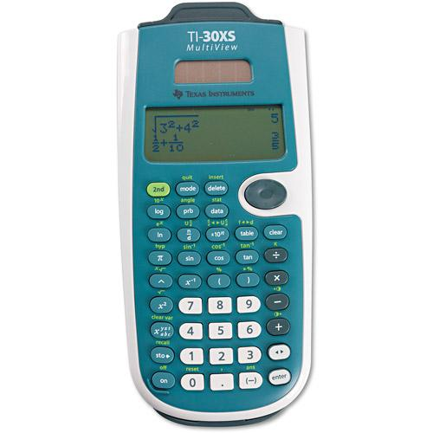
Calculators
Notes:
SOPHIA
Left is BA II plus financial calculator, which I found was really helpful for Exam FM, but supposedly doesn’t help for any other exam
Around $40 on amazon
Professional edition was a lot more expensive and you do NOT need any of those functions on the exam
Right is TI 30 XS multview
Multiview here is key because there is enough screen space like a graphing calculator, it’s great
$20
You can take both calculators into the exam with you
Don’t forget it or you’ll fail
When you’re doing practice problems, make sure you’re doing it with the calculator you are going into the exam with

Slide 15
Getting Hired
GPA
Networking
Extracurriculars
Exams
Interview
Computer Skills
Notes:
VICKY
GPA and Exams are what gets you the interview.
Needless to say, you need a spotless CV and good cover letter
Most of the time they don’t really read the cover letter
If those are subpar then extra curriculars are taken into account (weights are different depending on each firm)
Networking is key.
Going to company cocktails at the beginning of the semester September
a wine a cheese to chat with employers September
ASNA conference January – case competition
Join the MSAA listserv to get more information on all these events
(mostly planned by others)
Interviews can be either knowledge based or behavioural.
They want to know that you know what you say you know
And they want to know you’ll be a joy to have at the office
You’ll be nervous, do mock interviews!
Doing A LOT of interview prep is also required
Why you? Why us?
It’s very useful to know excel, access (base Microsoft applications) and then VBA and SQL for advanced knowledge
McGill CAPS has a lot of great resources to help you with CV, Cover Letter, and Interviewing, Mock Interviews

Slide 16
Networking Opportunities
Company Cocktails
ASNA
Company Presentations
Notes:
Networking is a crucial part of finding jobs
Spring/fall- companies have cocktails with actuaries and HR to meet students and promote their company
MSAA sometimes organizes presentations with companies. Ex Sunlife and Intact
ASNA: major actuarial students convention, details on next slide

Slide 17
ASNA
Annual Convention for Actuarial Students
Will be hosted in Toronto in January 2017
Dozens of insurance companies will be present
Networking and interview opportunities
Great opportunity to meet fellow aspiring actuaries and to learn about the field.

Slide 18
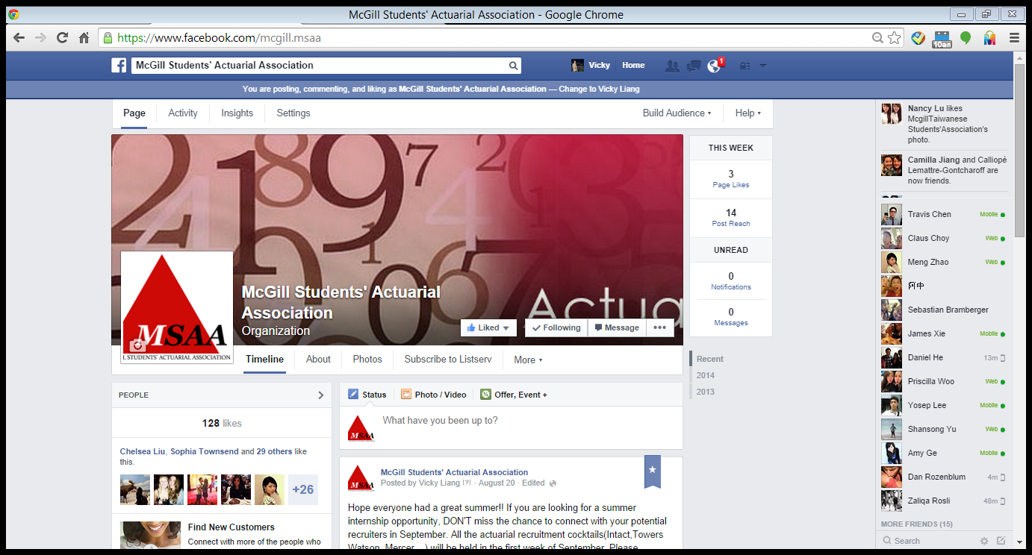
https://www.facebook.com/mcgill.msaa
Notes:
SOPHIA
Please subscribe to us!

Slide 19
Useful Resources
http://www.beanactuary.org/
http://www.soa.org/
http://www.casact.org/
http://www.actuary.ca/
http://www.studymanuals.com/

Slide 20
Questions
Questions?

